Slide 2

Introduction to FireDAC
Fundamentals of Data Access
Slides and samples github.com/jimmckeeth/FireDAC-Fundamentals

Slide 3


Jim McKeeth
GDK Software
Embarcadero Delphi MVP
Director of Consulting
jim@gdksoftware.com
gdksoftware.com

Slide 4
INTERFACE
SQL Refresher
Database access
Basics of FireDAC
Essential Components
Connecting to Local DB
Connecting to to Remote DB
Resources
Be sure to catch tomorrow's session: FireDAC: Your Secret Dataset Weapon August 13, 1:00 PM (CST)
Slides and samples
github.com/jimmckeeth/FireDAC-Fundamentals

Slide 5
Introduction to FireDAC: Fundamentals of Data Access
Jim McKeeth, GDK Software
jim@gdksoftware.com | www.gdksoftware.com
August 12, 1:00 PM (CST)
Do you want to access data in your application? FireDAC is the answer. This session provides a comprehensive introduction to the essentials of using FireDAC for accessing various types of data and databases across multiple platforms. Whether you're working with local databases or remote servers, you'll learn the foundational techniques to efficiently manage data in your Delphi applications. A basic understanding of SQL is recommended to make the most of this session. Be sure to catch the FireDAC: Your Secret Dataset Weapon session tomorrow!

Slide 6
IMPLEMENTATION

Slide 7





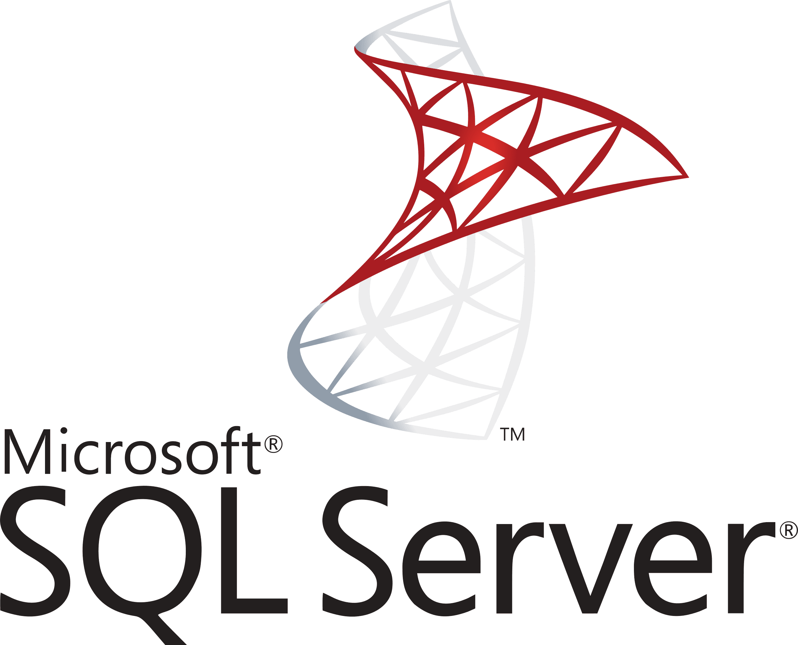
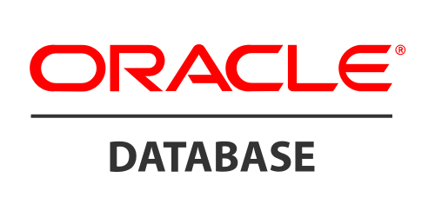










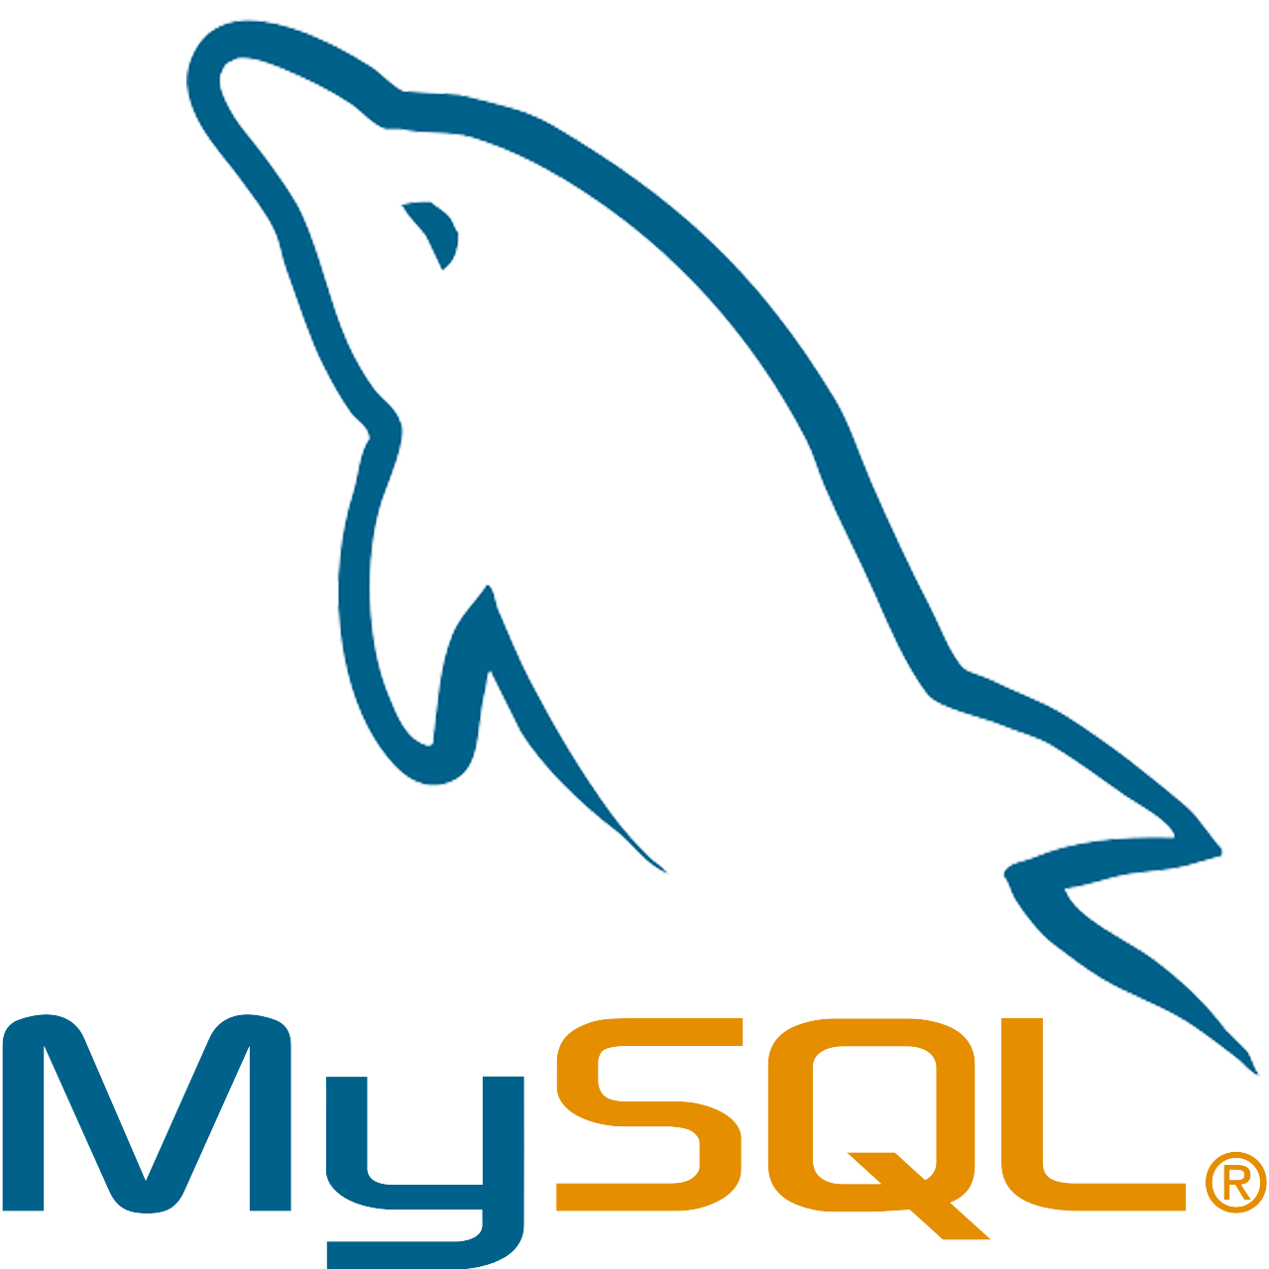

FireDAC Database Access
Universal data access components
Same components for all DBs
Platform independent
TDataset descendent
Data Aware, Live Binding, or GUI free
Database specific features

Slide 8
Top Databases
Rank | DBMS | Database Model | Score
1 | Oracle | Relational, Multi-model | 1258.48
2 | MySQL | Relational, Multi-model | 1026.86
3 | Microsoft SQL Server | Relational, Multi-model | 815.18
4 | PostgreSQL | Relational, Multi-model | 637.39
5 | MongoDB | Document, Multi-model | 420.98
6 | Redis | Key-value, Multi-model | 152.71
7 | Snowflake | Relational | 135.97
8 | Elasticsearch | Search engine, Multi-model | 129.83
9 | IBM Db2 | Relational, Multi-model | 123
10 | SQLite | Relational | 104.79
11 | Apache Cassandra | Wide column, Multi-model | 97
12 | Microsoft Access | Relational | 96.37
13 | Splunk | Search engine | 96.1
14 | MariaDB | Relational, Multi-model | 86.53
15 | Databricks | Multi-model | 84.46
16 | Microsoft Azure SQL Database | Relational, Multi-model | 75.03
17 | Amazon DynamoDB | Multi-model | 68.91
18 | Google BigQuery | Relational | 55.53
19 | Apache Hive | Relational | 55.24
20 | FileMaker | Relational | 46.67
21 | Neo4j | Graph | 43.9
22 | SAP HANA | Relational, Multi-model | 42.36
23 | Teradata | Relational, Multi-model | 42.25
24 | Apache Solr | Search engine, Multi-model | 36.3
25 | SAP Adaptive Server | Relational, Multi-model | 33.28
26 | Apache HBase | Wide column | 27.51
27 | Microsoft Azure Cosmos DB | Multi-model | 26.22
28 | InfluxDB | Time Series, Multi-model | 22.63
29 | PostGIS | Spatial, Multi-model | 20.06
30 | Firebird | Relational | 19.97
Top 30 DBMS ranked by db-engines.com

Slide 9
Top Databases
Rank | DBMS | Score
1 | Oracle | 1258.48
2 | MySQL | 1026.86
3 | Microsoft SQL Server | 815.18
4 | PostgreSQL | 637.39
5 | MongoDB | 420.98
7 | Snowflake | 135.97
9 | IBM Db2 | 123
10 | SQLite | 104.79
12 | Microsoft Access | 96.37
14 | MariaDB | 86.53
16 | Microsoft Azure SQL Database | 75.03
18 | Google BigQuery | 55.53
19 | Apache Hive | 55.24
20 | FileMaker | 46.67
22 | SAP HANA | 42.36
23 | Teradata | 42.25
25 | SAP Adaptive Server | 33.28
30 | Firebird | 19.97
Top 30 DBMS ranked by db-engines.com
Remove "non-relational"
Leave MongoDB (most popular non-relational DB)

Slide 10
Top Databases
Rank | DBMS | Score
1 | Oracle | 1258.48
2 | MySQL | 1026.86
3 | Microsoft SQL Server | 815.18
4 | PostgreSQL | 637.39
5 | MongoDB | 420.98
7 | Snowflake | 135.97
9 | IBM Db2 | 123
10 | SQLite | 104.79
12 | Microsoft Access | 96.37
14 | MariaDB | 86.53
16 | Microsoft Azure SQL Database | 75.03
18 | Google BigQuery | 55.53
19 | Apache Hive | 55.24
20 | FileMaker | 46.67
22 | SAP HANA | 42.36
23 | Teradata | 42.25
25 | SAP Adaptive Server | 33.28
30 | Firebird | 19.97
Top 30 DBMS ranked by db-engines.com
Remove "non-relational"
Leave MongoDB (most popular non-relational DB)
Highlight native supported
Full list: docwiki/RADStudio/en/Databases_(FireDAC)

Slide 11
BEGIN

Slide 12
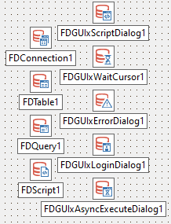
FireDAC Components [Basics]
TFDConnection: Connection to DB
TFDTable: A single DB table
TFDQuery: SQL statement, multiple tables, read and write
TFDScript: Collection of scripts
TFDGUIxWaitCursor: Wait cursor (VCL, FMX, Console)
TFDGUIxLoginDialog: Control login dialog (VCL, FMX)
TFDGUIxErrorDialog: FireDAC exceptions (VCL, FMX)
TFDGUIxScriptDialog: Script progress (VCL, FMX, Console)
TFDGUIxAsyncExecuteDialog: Query progress (VCL, FMX)

Slide 13
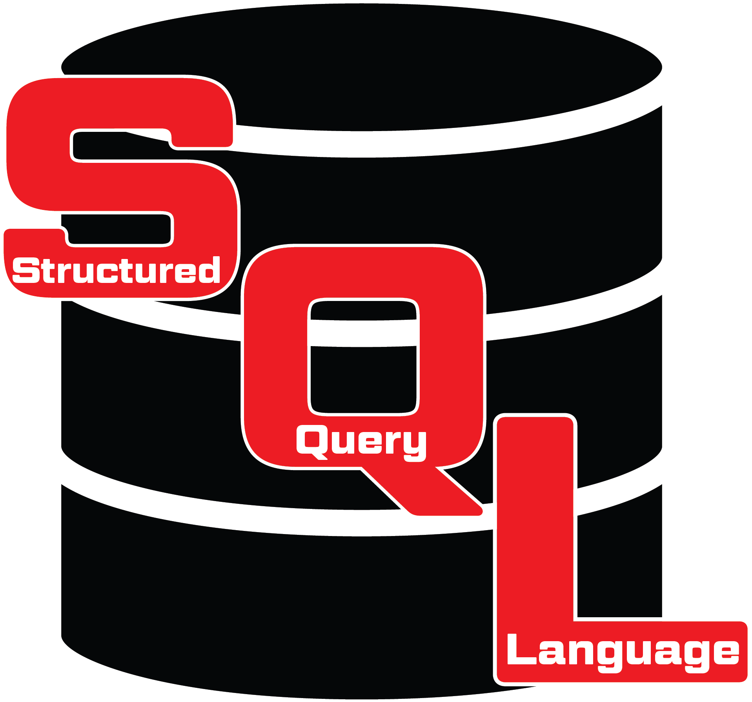
Working with DBMS
Database
Base
Management
System

Slide 14
Working with SQL
Structured
Query
Language
Commonly used with DBMS
Universal with specific dialects

Slide 15
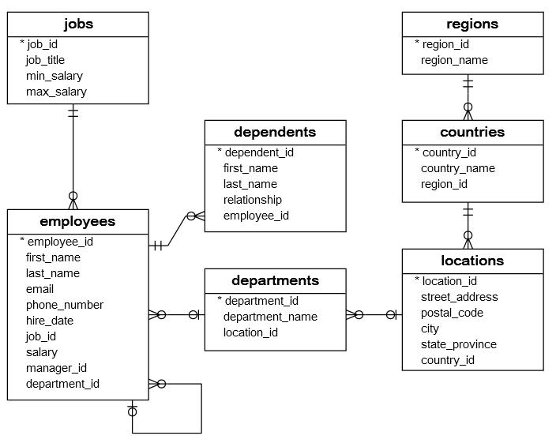
Working with SQL
# | Table | Description | Rows
1 | employees | stores the data of employees. | 40
2 | jobs | stores the job data including job title and salary range. | 30
3 | departments | table stores department data. | 11
4 | dependents | stores the employee’s dependents. | 11
5 | locations | stores the location of the departments of the company. | 7
6 | countries | stores the data of countries where the company is doing business. | 25
7 | regions | the data of regions such as Asia, Europe, America, and the Middle East and Africa. The countries are grouped into regions. | 4
sqltutorial.org/sql-sample-database/

Slide 16
Working with SQL
Each record has an ID unique in that table
Employees have 1 job, 1 department, and 0 to many dependents, stored in separate tables
They also have 1 manager, which is stored in the employee table
Departments have 1 location
Locations have 1 country
Countries have 1 region
sqltutorial.org/sql-sample-database/

Slide 17
SQLite
A very simple DBMS that exists as a library functioning as an embedded DBMS. Works across most all platforms.
Lacks some features common to other DBMS.
Often enough for simple use cases.
docwiki/RADStudio/en/Using_SQLite_with_FireDAC ←
docwiki/RADStudio/en/Connect_to_SQLite_database_(FireDAC)
docwiki/RADStudio/en/Tutorial:_Connecting_to_a_SQLite_Database_Using_FireDAC
docwiki/RADStudio/en/Mobile_Tutorial:_Using_FireDAC_and_SQLite_(iOS_and_Android)
docwiki/RADStudio/en/SQLite_Database_Questions_(FireDAC)
sqlite.org

Slide 18
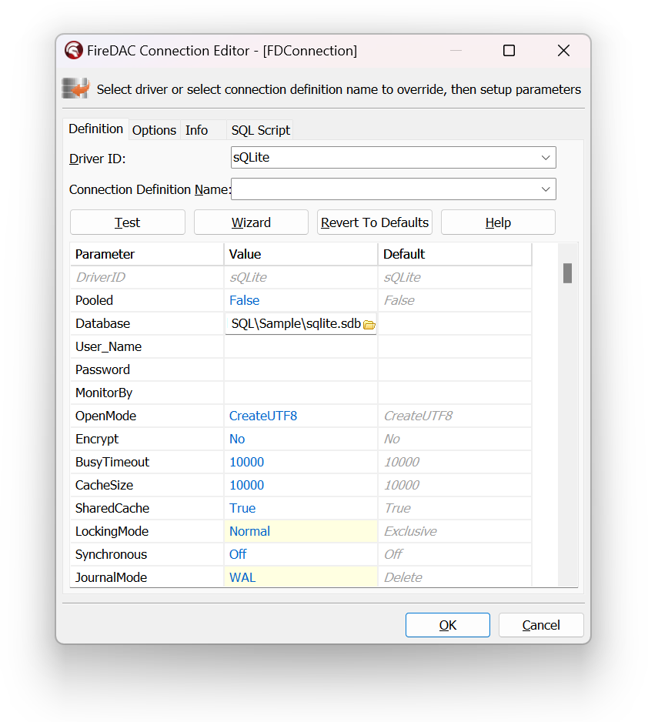
SQLite with FireDAC
DriverID: SQLite
Database: path to db file (defaults to creating if doesn't exist)
For shared access
JournalMode: WAL
LockingMode: Normal

Slide 19
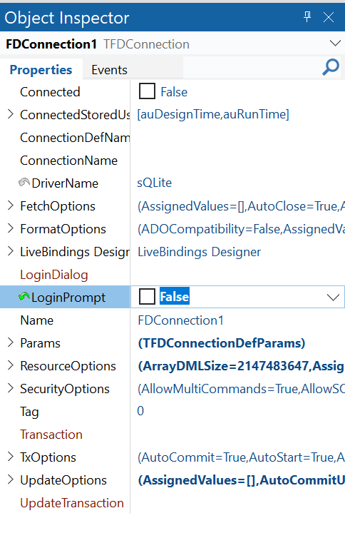
SQLite with FireDAC
LoginPrompt: False
Not usually needed
Notes:
SQLite doesn't store field sizes
TEXT = dtWideMemo
MEMO = dtMemo
NVARCHAR = dtWideString
VARCHAR = dtAnsiString
More on SQLite_Data_Types

Slide 20
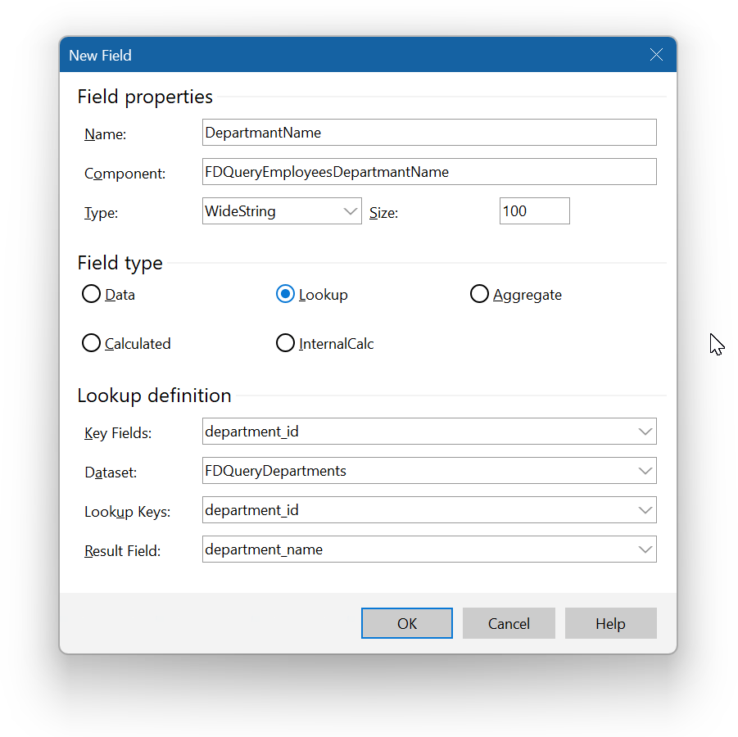
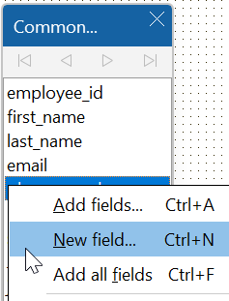
DBGrid Lookup
Add a new field to the TFDQuery
Give it a name and type
Set Field Type as lookup
Connect the local key field to the key field of the other dataset
Result field is displayed

Slide 21
Demonstration

Slide 22

Note on Containers
Docker is the kleenex of container platforms
Recently introduced new license restrictions
Podman is a new alternative from RedHat
Full compatibility and possibly more secure
Open Container Initiative (OCI) compliant
Full containers ecosystem
Use with hub.docker.com, quay.io, or other registries
Worth consideration!
github.com/containers/podman
podman.io

Slide 23
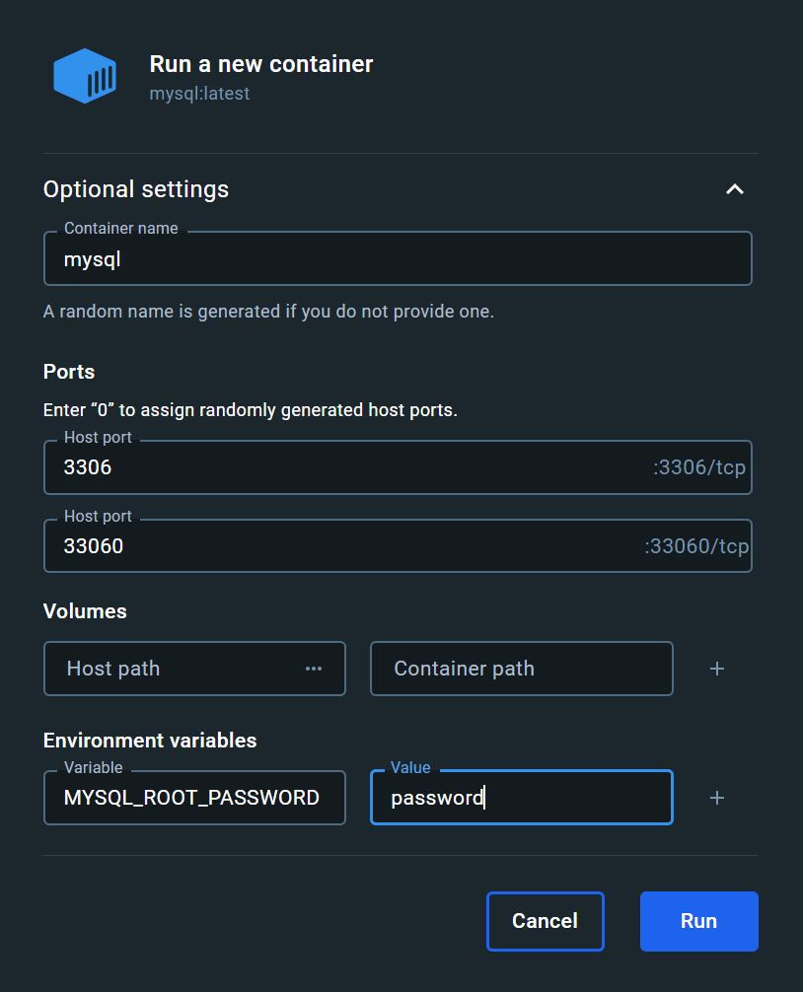
MySQL
Midrange RDBMS
local, embedded or remote
Now owned by Oracle with 4 editions
1 free, and the other 3 paid
Very difficult to get client libraries
Current client only 64-bit
Links: hub.docker.com/_/mysql
Supply: MYSQL_ROOT_PASSWORD
docwiki/RADStudio/
Connect_to_MySQL_Server_(FireDAC)
MySQL_Server_Questions_(FireDAC)

Slide 24
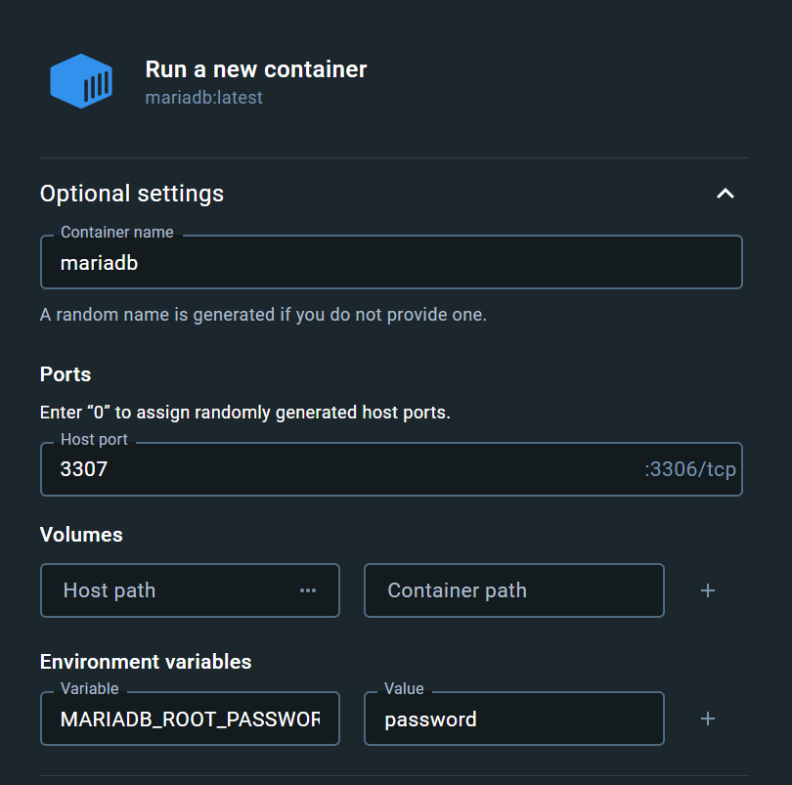
MariaDB
New open source (GPLv2) fork of MySQL
Intended to maintain high compatibility
Easy to get 32 or 64-bit client libraries
Which are compatible with MySQL
mariadb.com/kb/en/mariadb-connector-c/
Refer to MySQL in DocWiki and FireDAC
The FireDAC MySQL native driver supports:
MySQL Server Community, Enterprise, and Embedded editions, from version 3.21 up to version 8.0.23.
MariaDB, from version 5.5 up to version 10.6.
Recommend using MariaDB over MySQL
hub.docker.com/_/mariadb
MARIADB_ROOT_PASSWORD

Slide 25
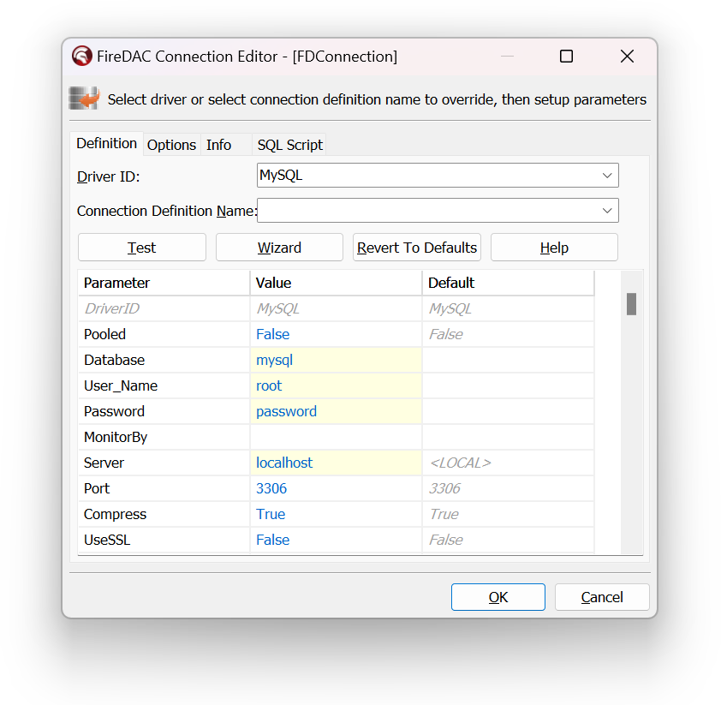
MySQL & MariaDB
Download and install drivers
mariadb.com/kb/en/mariadb-connector-c/
DriverID: MySQL
Server: name or IP
Port: 3306 (default)
Database: mysql (default-case sensitive)
Instance name within server
DocWiki/Connect_to_MySQL_Server_(FireDAC)

Slide 26

Demonstration

Slide 27
FINALIZATION
Slides and samples
github.com/jimmckeeth/FireDAC-Fundamentals

Slide 28
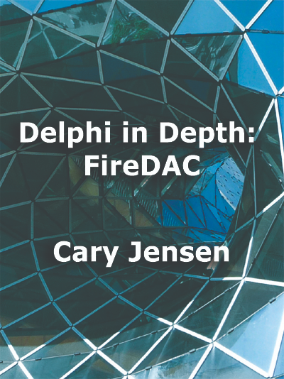
FireDAC in Depth
The definitive book about FireDAC
by Spirit of Delphi winner Dr. Cary Jensen
jensendatasystems.com/firedacbook
Learn how to connect to a wide variety of databases
Optimize your connection configurations
Explore the world of indexes, searches, and filters
Discover the power of persisted datasets
Create flexible queries using macros and FireDAC scalar functions
Achieve blazing performance with Array DML
Master the art of cached updates
Add sophisticated features using Local SQL

Slide 29
Resources
See you tomorrow
FireDAC: Your Secret Dataset Weapon August 13, 1:00 PM (CST)
FireDAC DocWiki:
docwiki/RADStudio/en/Firedac
docwiki/RADStudio/en/Overview_(FireDAC)
docwiki/RADStudio/en/Getting_Started_(FireDAC)
docwiki/RADStudio/en/FAQ_(FireDAC)
SQL Reference
SQLTutorial.org
en.wikibooks.org/wiki/Structured_Query_Language
w3schools.com/sql
khanacademy.org/computing/computer-programming/sql
codecademy.com/learn/learn-sql
Slides and samples
github.com/jimmckeeth/FireDAC-Fundamentals

